Slide 1
Making Friends with Astrology
Knowing the astrology of people, as well as of the present, past and future times, enables us to see the world through others’ eyes; to experience their needs, fears and pleasures, as if they were our own. We see and feel responsible for a complete Universe.
Roy will illustrate this with individual charts, synastry and historical astro-events and, looking ahead, suggest how such insight could help everyone create a better future.
3.45 – 5.00 pm Gila Monster Room​​ ​

Slide 2
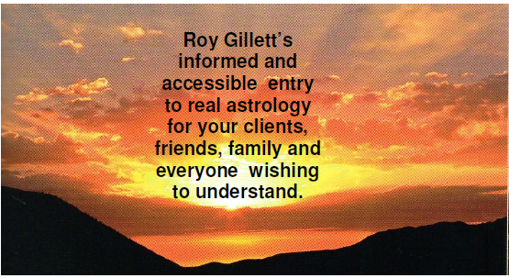
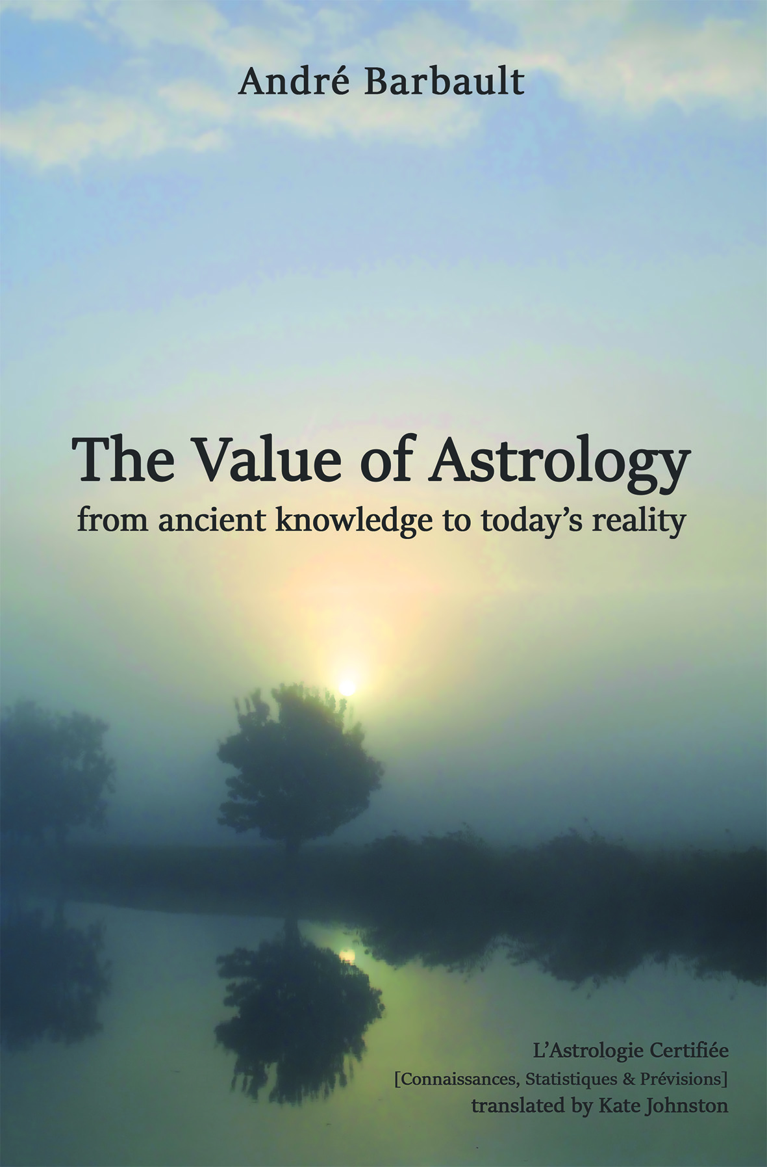
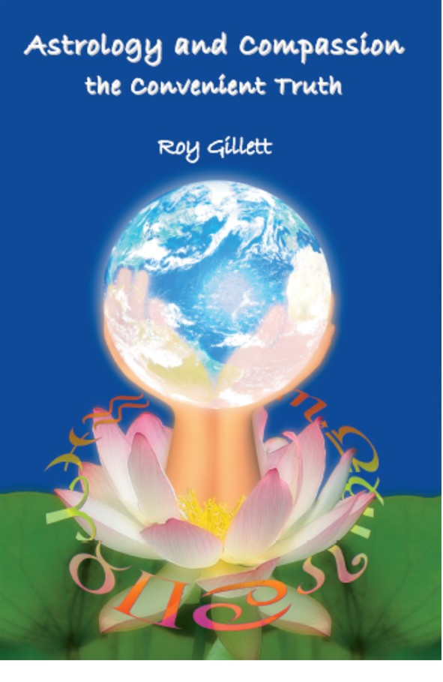
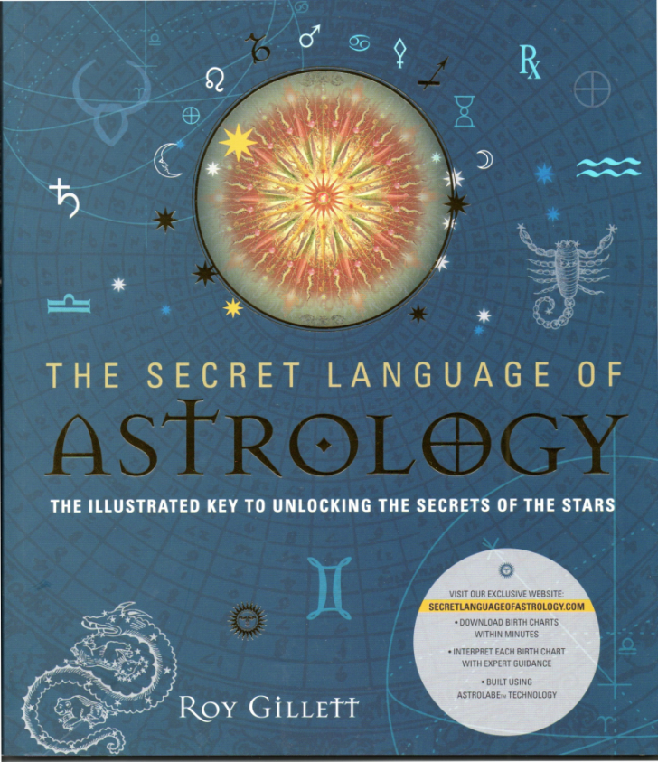
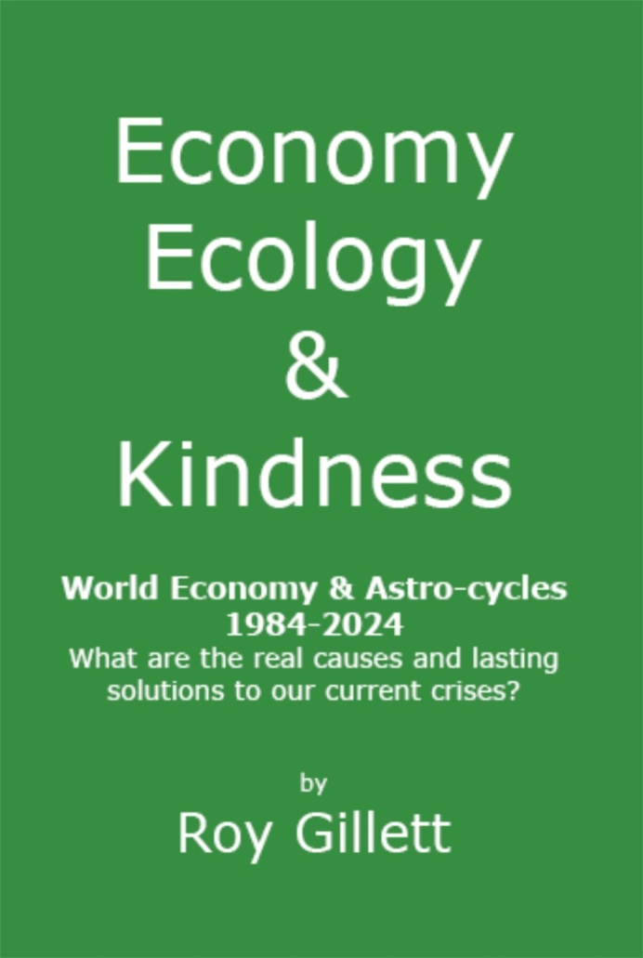
Order Software and the books from:
http://www.crucialastrotools.co.uk

Slide 3
Contents
Seeing People at their Worst and Best
Seeing Relationships at their Worst and Best
Making the Worst and Best Use of the Transits

Slide 4
Seeing People at their Worst and Best

Slide 5
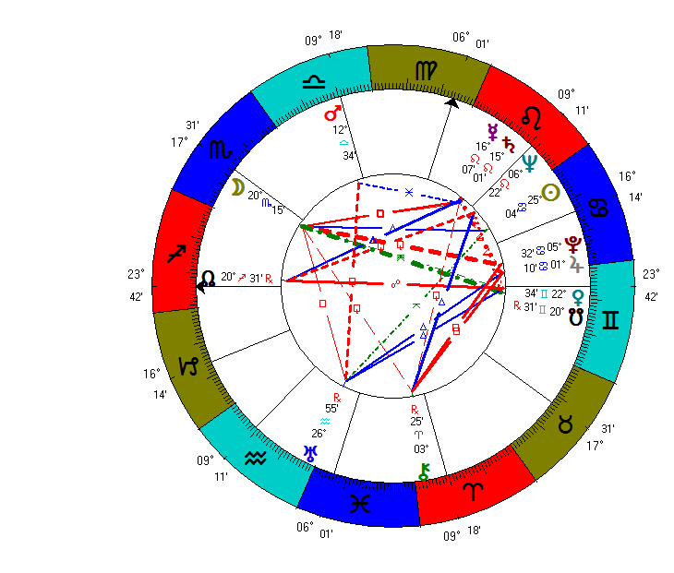

Slide 6
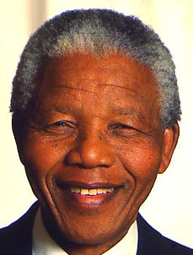

Slide 7
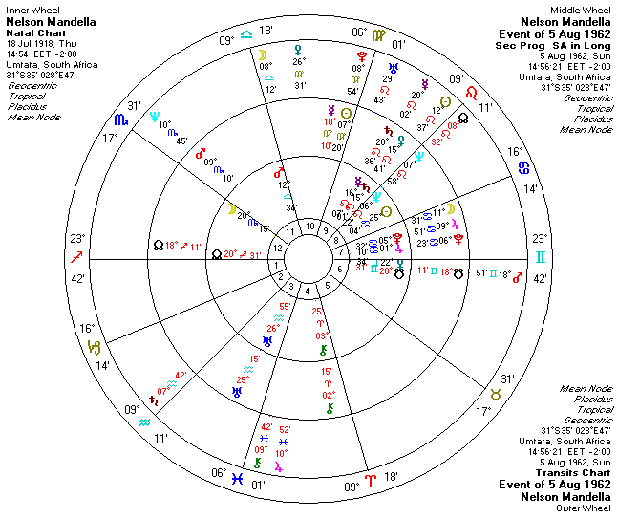
Imprisoned as a Terrorist

Slide 8
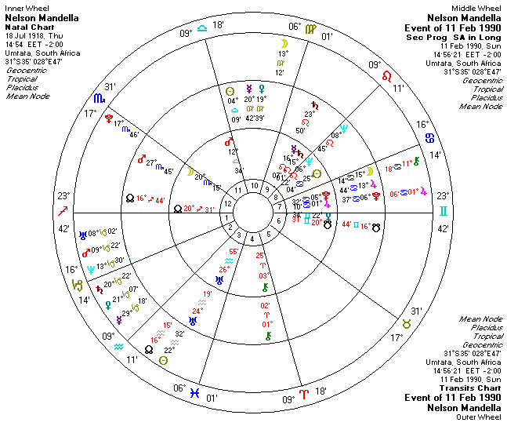
Released from
Prison

Slide 9
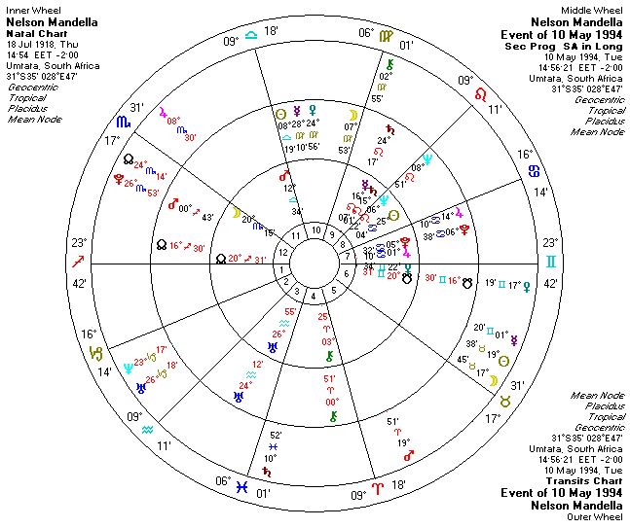
Sworn in as President of South Africa

Slide 10
Seeing Relationships
at their Worst and Best

Slide 11
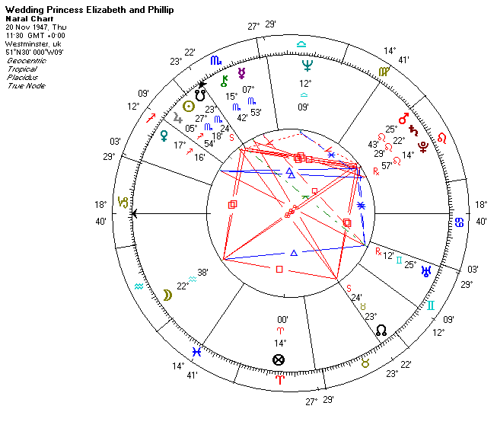
What sort of life together did this wedding point to?
Was it a good and lasting relationship?

Slide 12
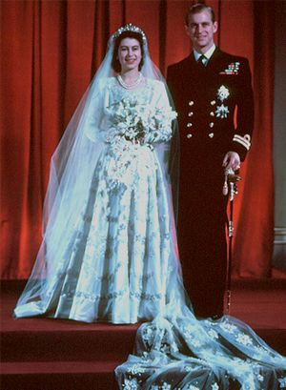

Slide 13
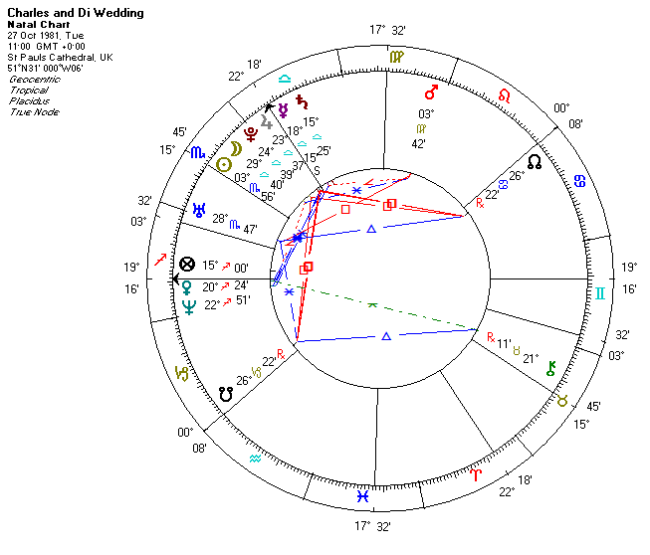
What sort of life together did this wedding point to?
Was it a good and lasting relationship?

Slide 14
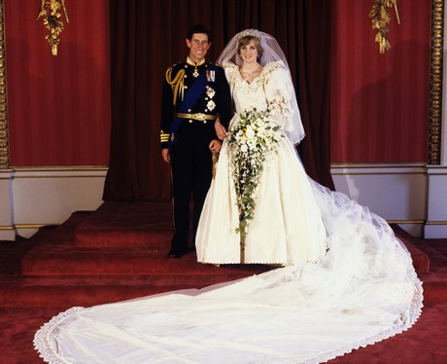
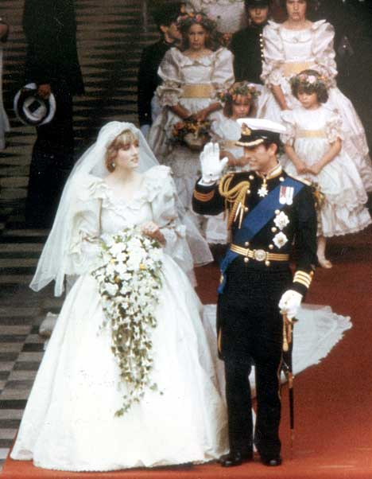
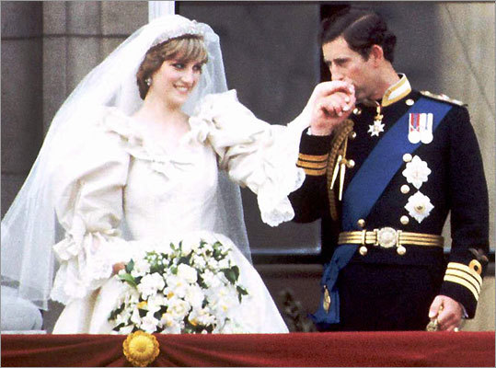

Slide 15
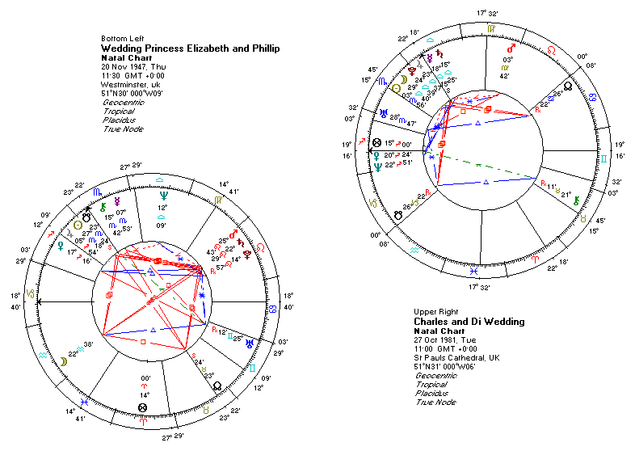

Slide 16
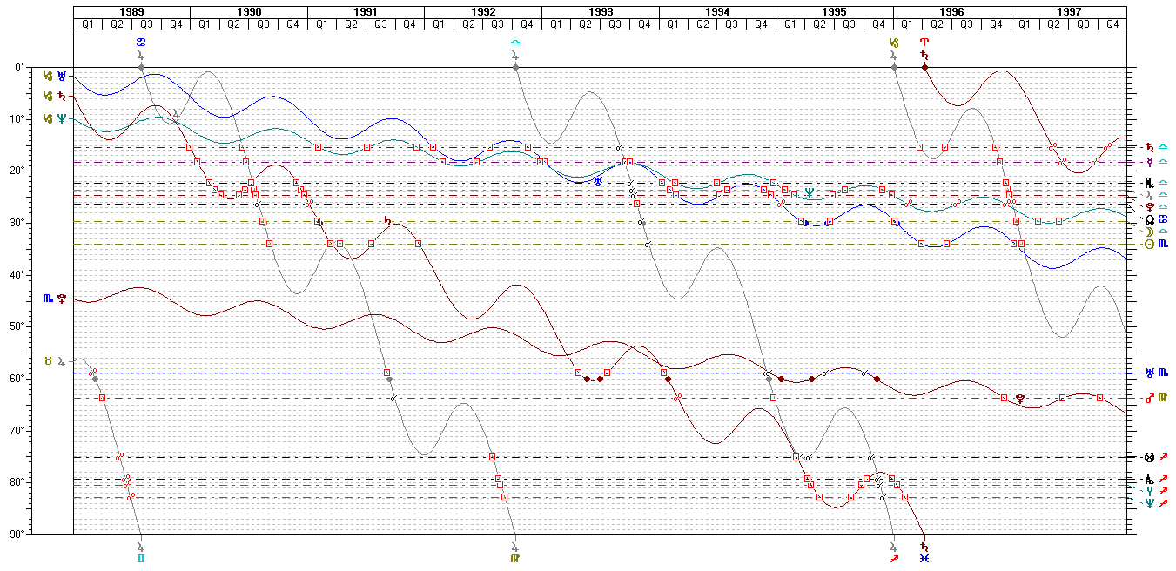
Transits January 1989-98 to Charles and Di Wedding Chart

Slide 17
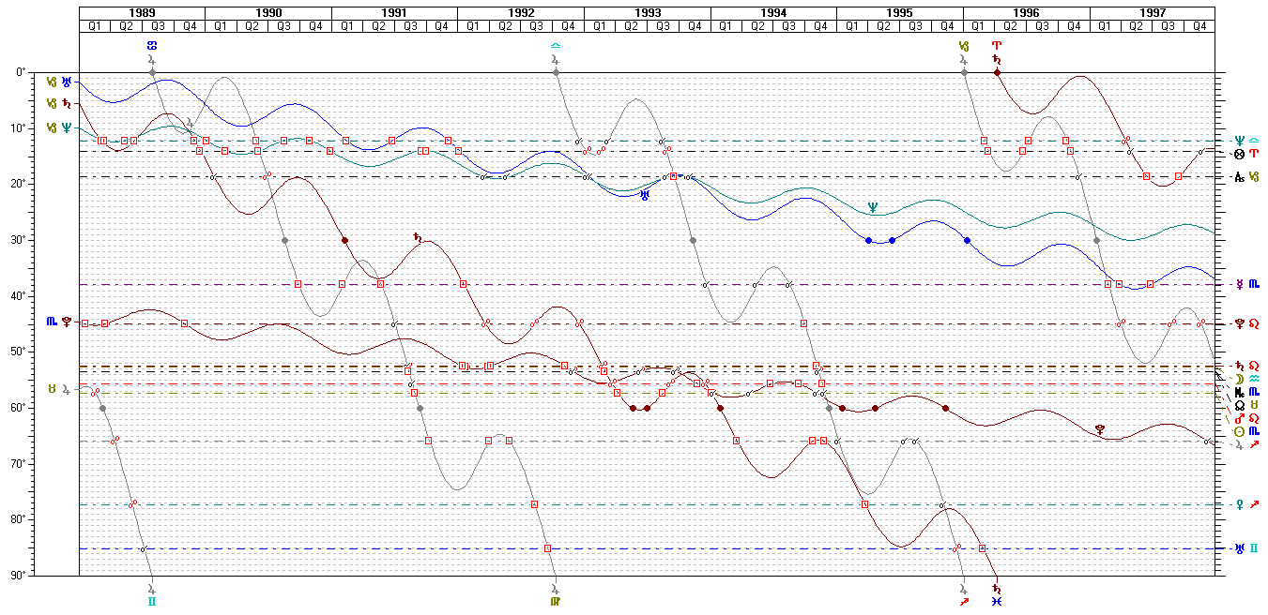
Transits January 1989-98 to Elizabeth and Phillip Wedding Chart
Annus
Horribilis

Slide 18
Making the Worst and Best Use of the Transits

Slide 19
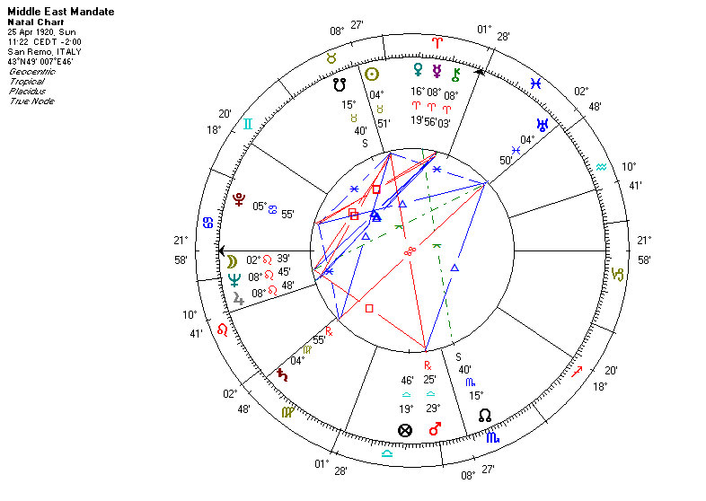
Good time to make important organisational decisions?

Slide 20
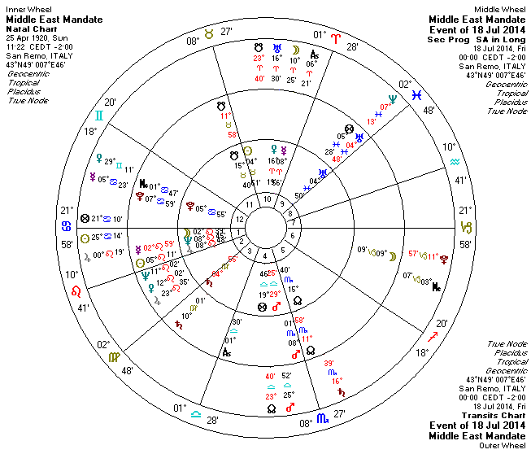
11 day offensive upgraded to ground invasion of Gaza
Animate in Solar Fire the progress of the violence and killing since the ground offensive

Slide 21
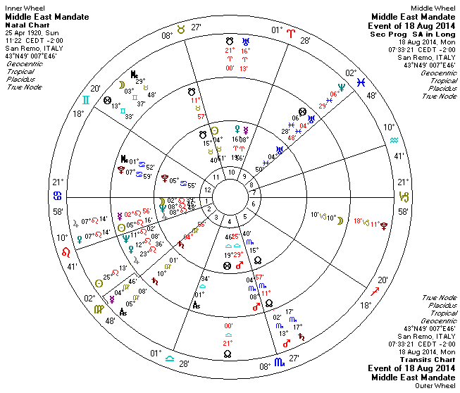
Jupiter conjuncts Venus - Andre Barbault’s Peace Negotiations / Armistice indicater

Slide 22
Order Software and the books from:
http://www.crucialastrotools.co.uk

